Slide 1
KARAMOJA CROP SEASON
Group 7

Slide 2
OBJECTIVES
What is the average Sorghum and Maize yield across the subcounties and districts of Karamoja?
Distinguish the area of Maize and Sorghum across Karamoja.
How are the Karamoja districts performing in terms of crop production?
Which areas are at risk of food insecurity?
Which sub county is the most vulnerable for crop production?

Slide 3
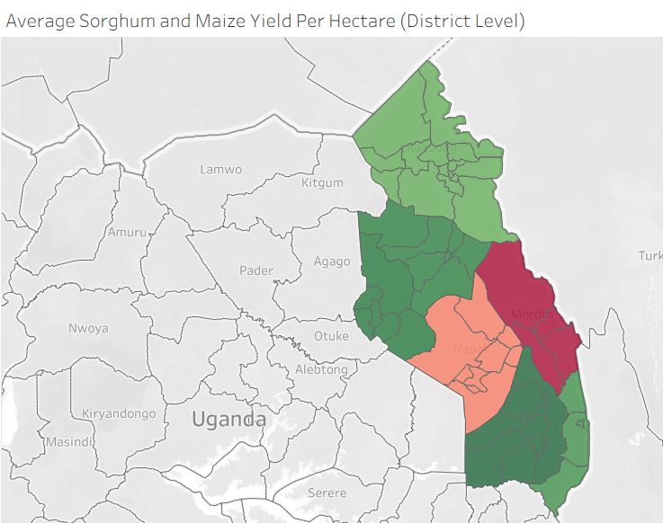
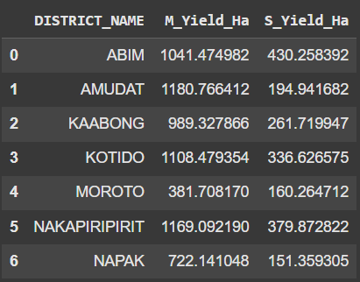
AVERAGE SORGHUM AND MAIZE YIELD PER HECTARE
DISTRICT LEVEL:

Slide 4
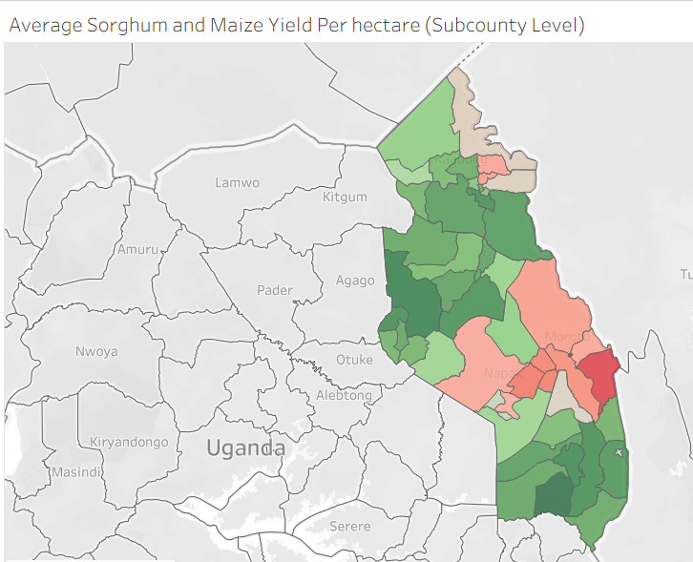
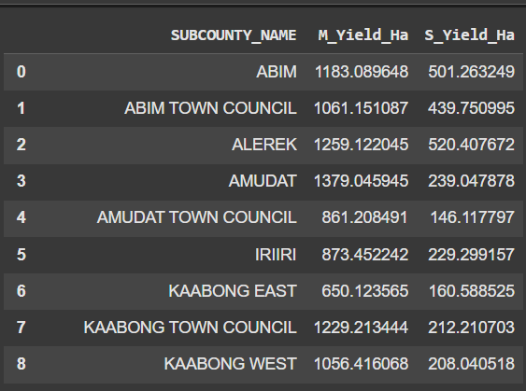
CONTINUATION…
SUB COUNTY LEVEL:

Slide 5
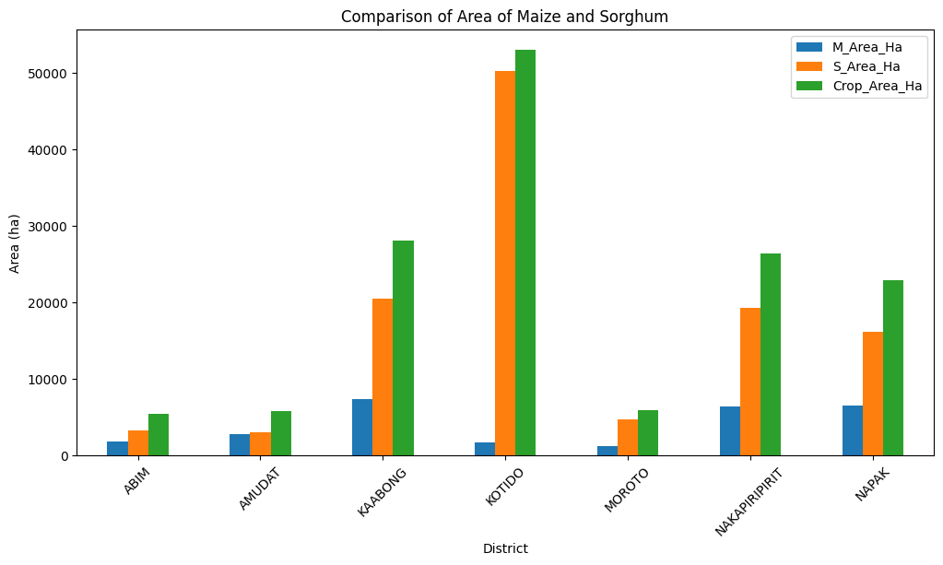
2) COMPARISON OF AREA FOR MAIZE AND SORGHUM

Slide 6
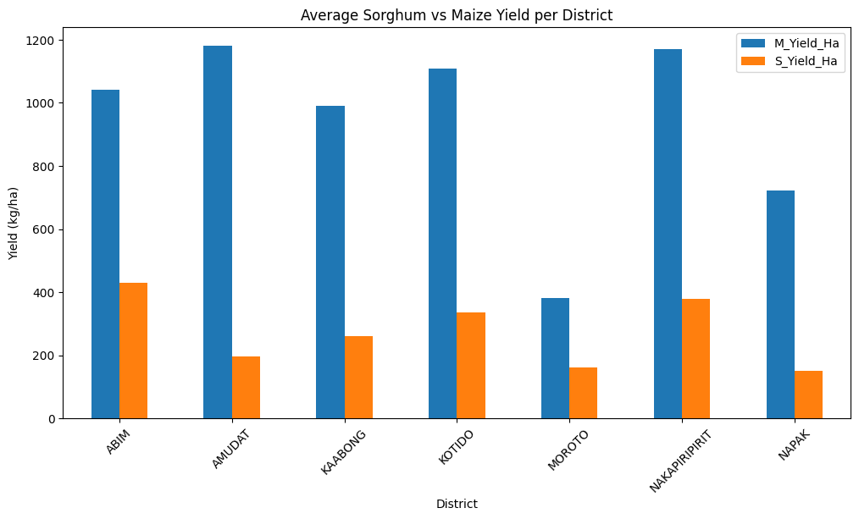
3) CROP PERFORMANCE PER DISTRICT

Slide 7
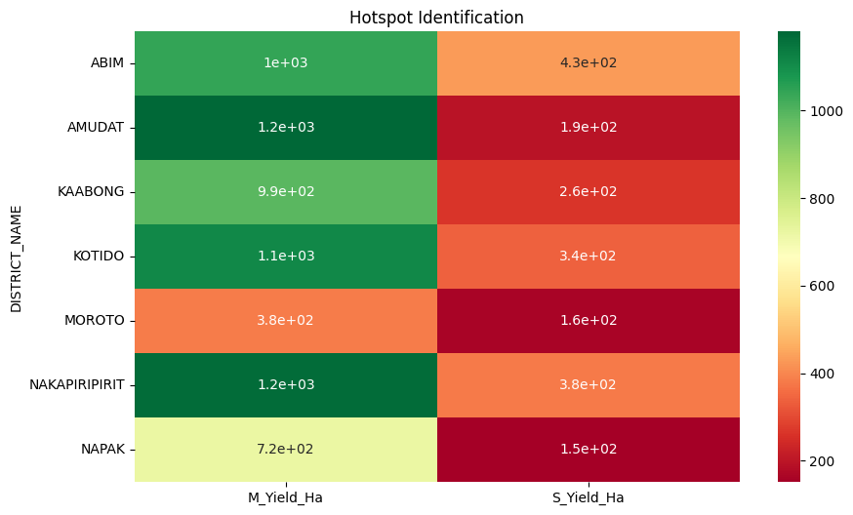
4) HOTSPOT IDENTIFICATION

Slide 8
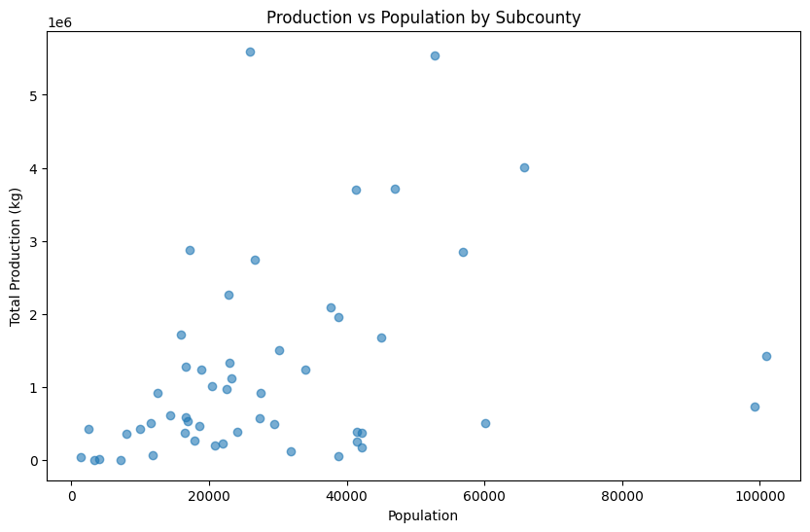
5) CROP PRODUCTION VS POPULATION

Slide 9
FINDINGS..
1. Sorghum yields are generally lower than maize yields across districts.
2. The best-performing district shows significantly higher productivity, while some subcounties are still lurking behind.
3. Population is unevenly distributed; some subcounties with large populations still show low production, creating food insecurity risks.
4. Choropleth maps reveal clear spatial disparities, with certain districts consistently underperforming.
5. NGOs can prioritize interventions in hotspot subcounties where both yield and total production are low but population is high.

Slide 10
CONCLUSION
Average yield maps highlight that maize is outperforming sorghum region-wide. However, sorghum’s lower productivity, especially in Napak and Moroto, poses a food security concern, as these are staple crops for Karamoja’s population.
Therefore, districts with low sorghum yield + high population should be prioritized by NGO for food security interventions.

Slide 11
THANK YOU!!!

